Slide 1
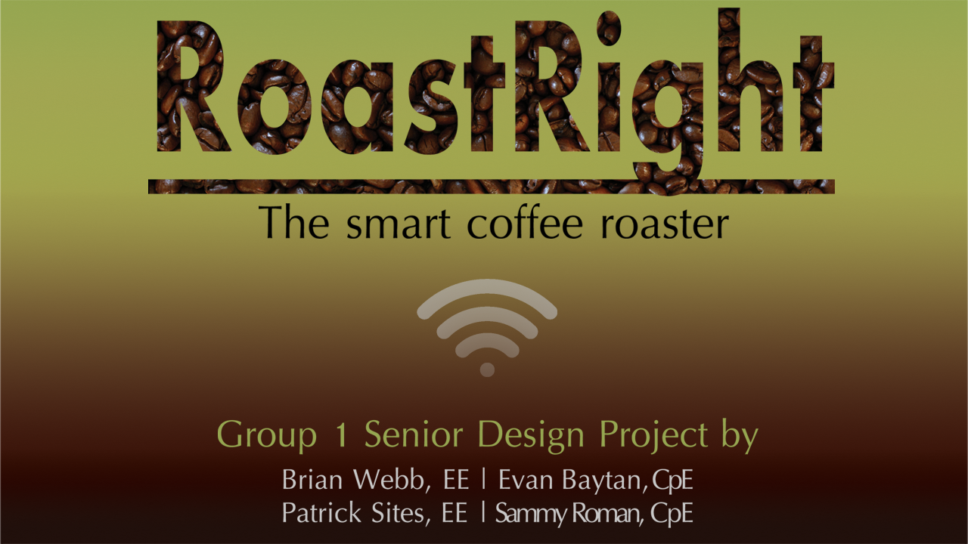

Slide 2

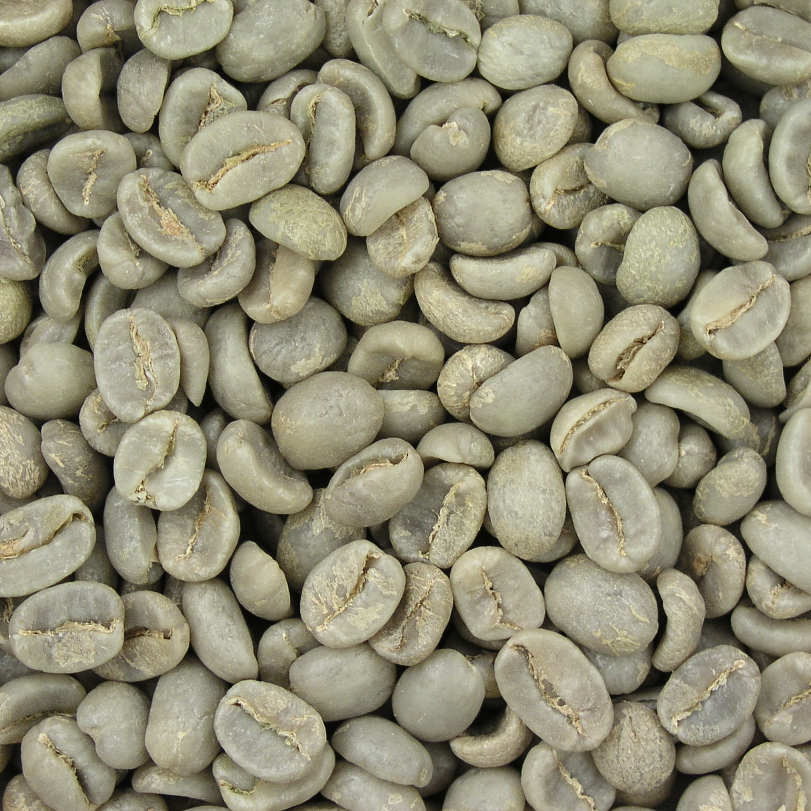
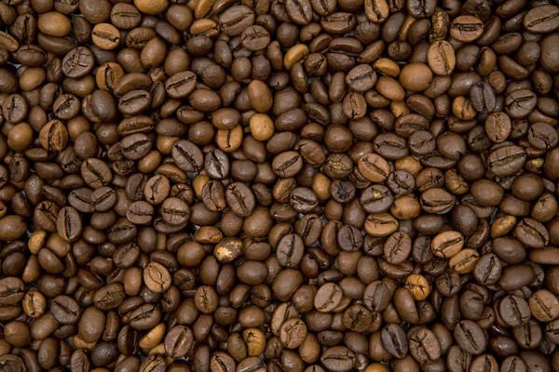
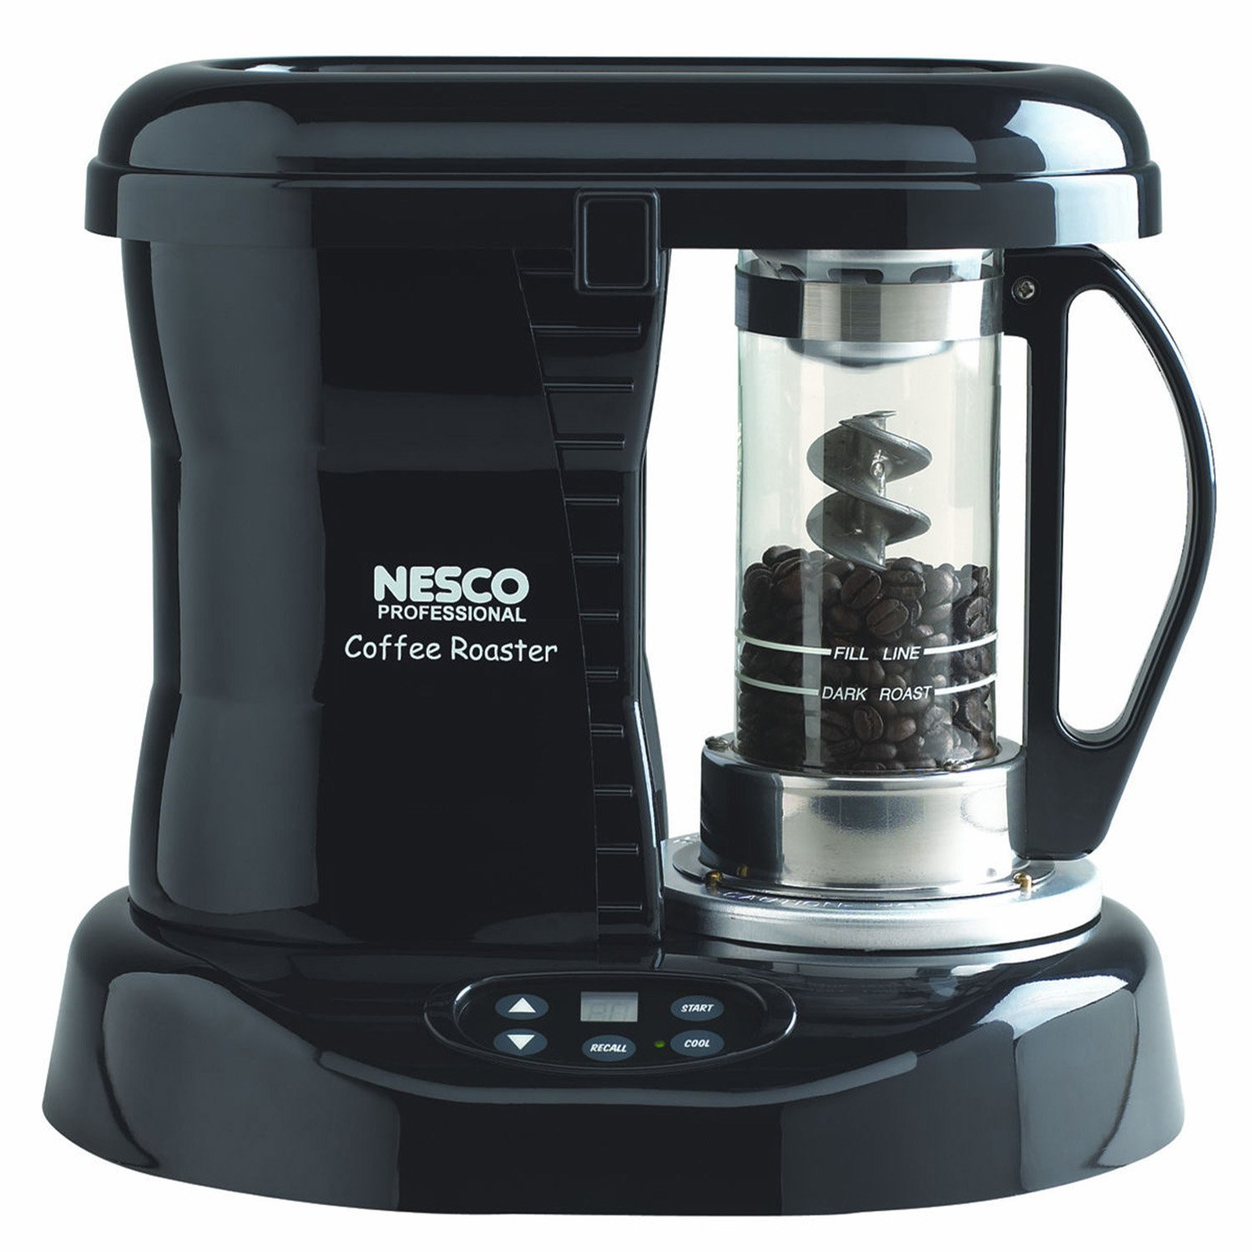
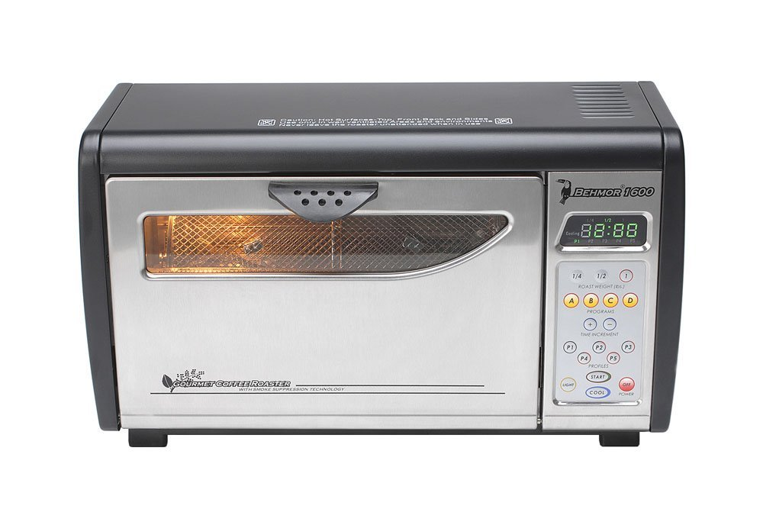
Project Overview
What is a coffee roaster?
Coffee is typically roasted and ground when purchased on store shelves
Coffee beans are initially green and turn their familiar brown color during the roasting process
A majority of coffee drinkers brew their own coffee, but some are beginning to experiment with roasting as well
Coffee roasters typically come in two styles: Air or Drum.

Slide 3
Motivation Goals & Objectives
Introduce more consumers to freshly roasted coffee
Create a convenient solution that will not sacrifice time for quality
Utilize current technology and design principles to create a friendly and enjoyable user experience
Provide more home automation options for customers to add to their already existing devices (Nest, Phillips Hue)
Control and monitoring of the coffee roaster using an iPhone or Apple Watch
Additional secondary controls through the onboard touchscreen display
Ability to successfully roast coffee of different roast profiles and types (Light, Medium, Dark)
Community aspect that will allow the ability to view and add new roast profiles
Order more coffee beans through iOS/watchOS applications

Slide 4
Specifications and Requirements
Reach temperatures of 244°C
Pull at most, 15A of current
Handle up to 1lbs of coffee at a time
Minimal background app activity to maintain low battery usage
Achieve a French Roast
Automatically scale roasting profile based on amount of coffee that is used
Have feedback from the coffee roaster to determine where it is in roasting process

Slide 5
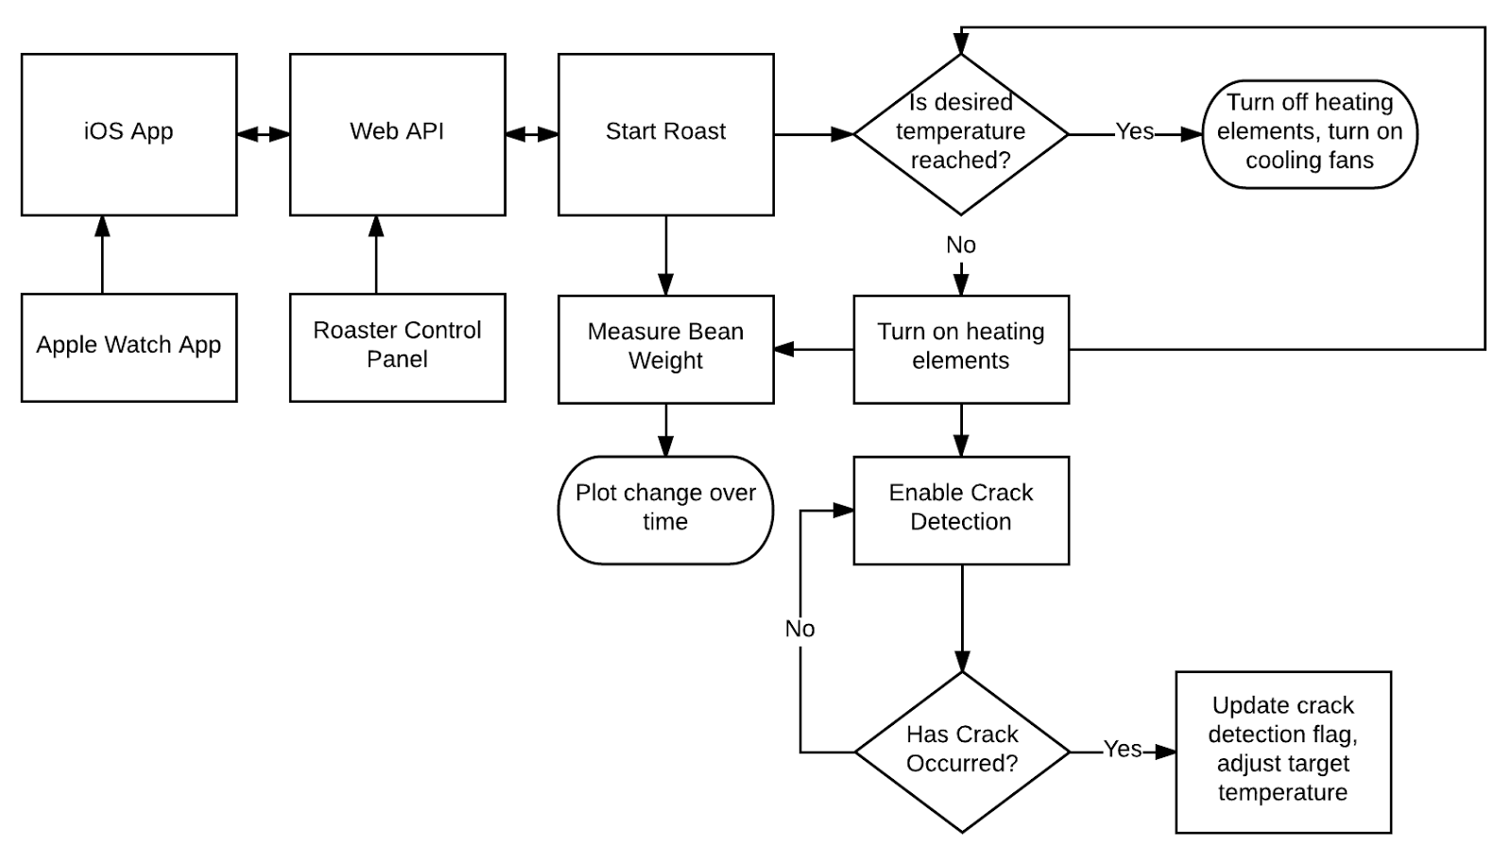
Overall Project Block Diagram

Slide 6
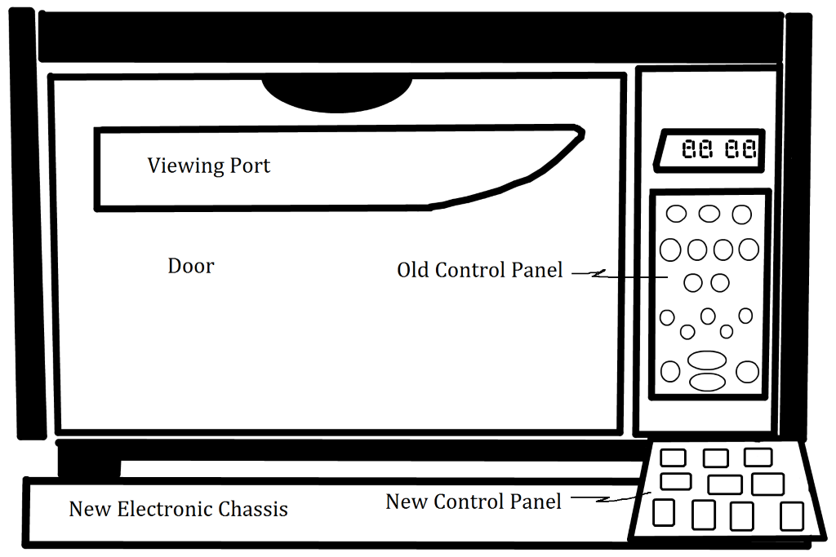
Hardware Design
All hardware will appear in added base, as shown.
Provides thermal insulation and easier work area.

Slide 7
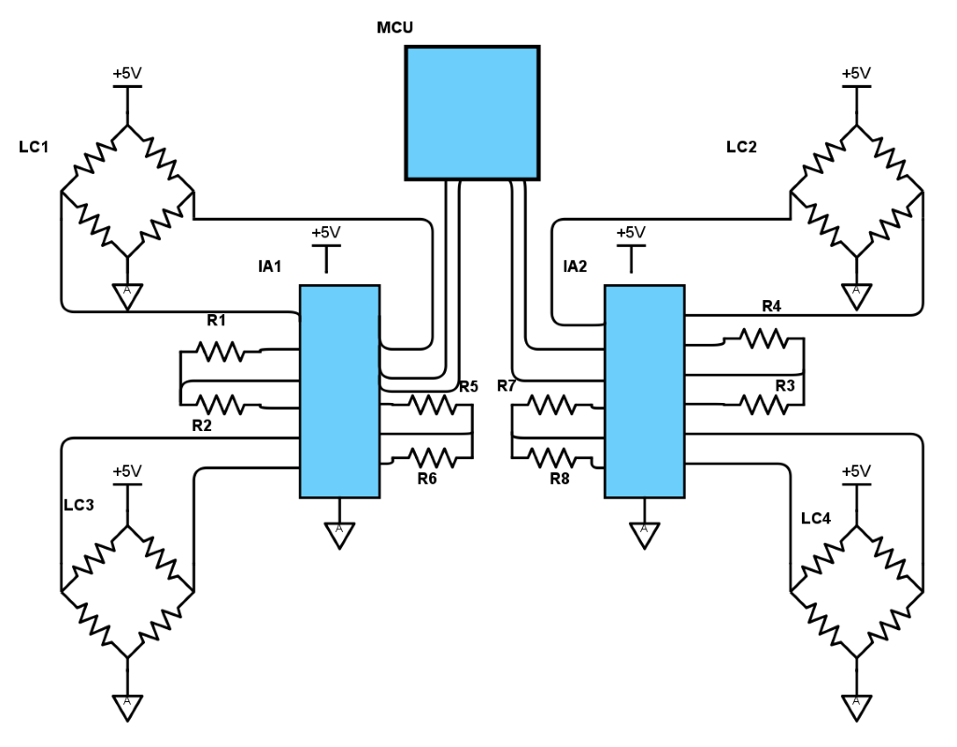
Weight Sensor
Four load cells, one on each corner
Load Cells represented as Wheatstone Bridge
Uses instrumentation amplifier to get reasonable gain

Slide 8
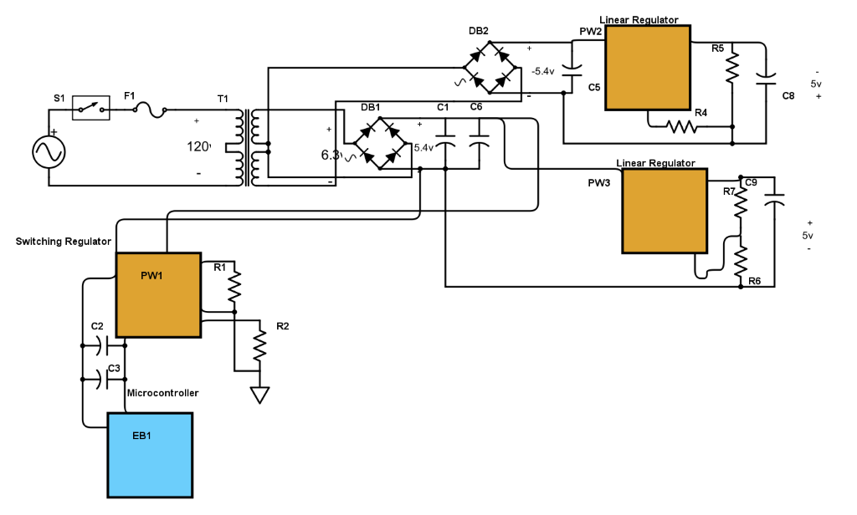
AC to DC Power System
Regulated power converters
Switching
Linear
Bipolar design
Power digital and analog circuitry

Slide 9
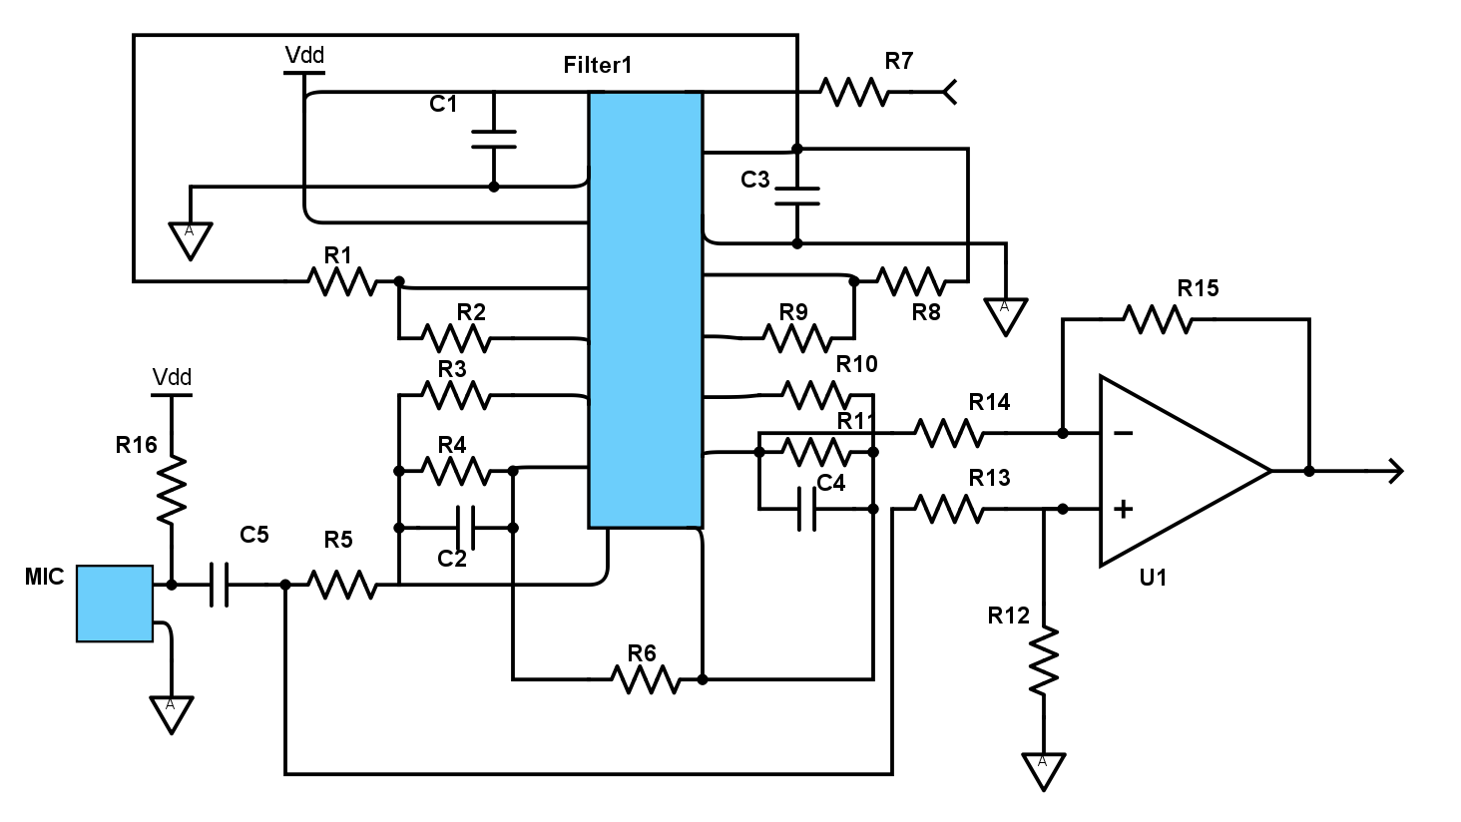
Crack Detection
Audio based
Remove noise with analog filter
Use threshold detection in MCU

Slide 10
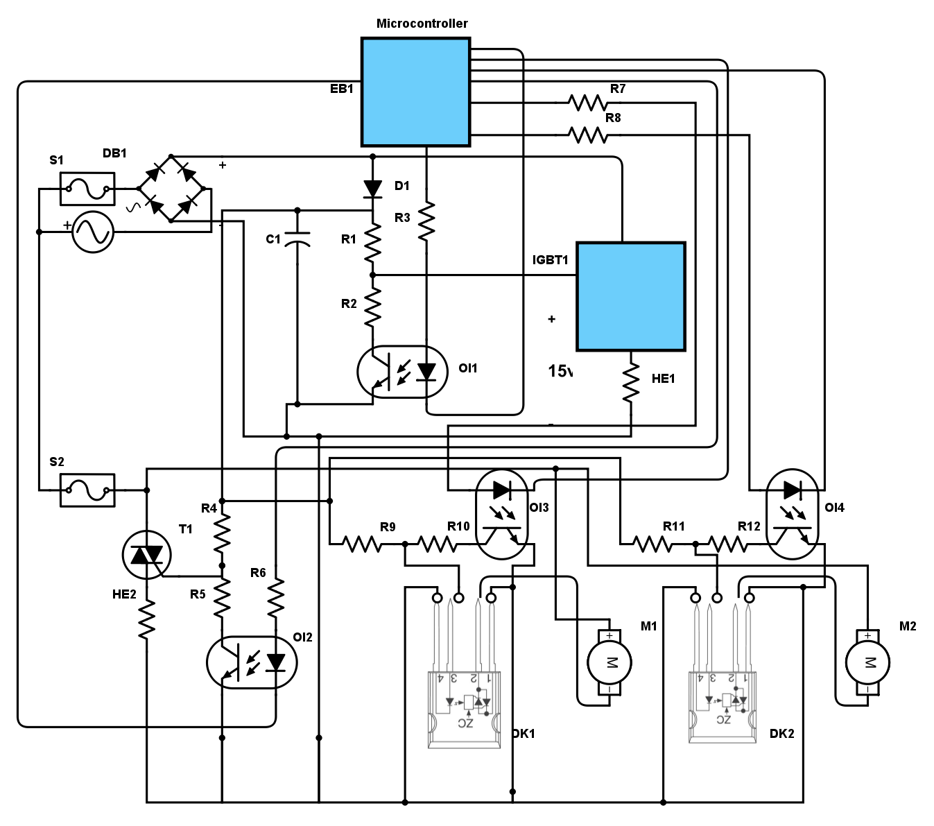
Control System
Controls heating elements and fans
AC and DC components

Slide 11
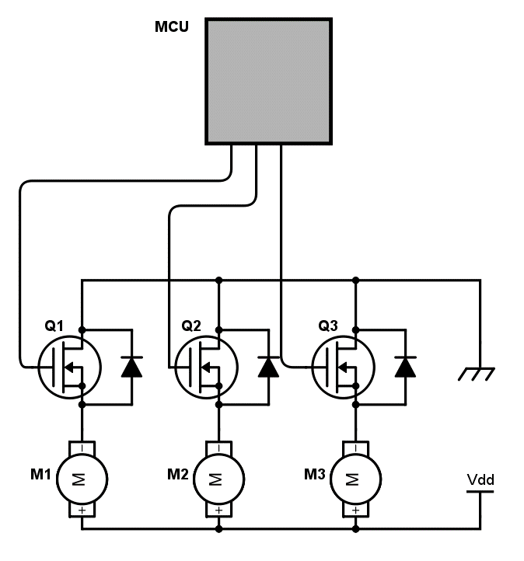
Control System
Controls heating elements and fans
AC and DC components

Slide 12
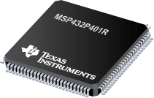
MCU
MSP432P401R
Up to 48MHz
256KB RAM
4-pin JTAG support
Ultra Low Power (90㎂/MHz)
Overall package size 14x14mm
Built in DC-DC conversion
Real-time clock
ADC

Slide 13
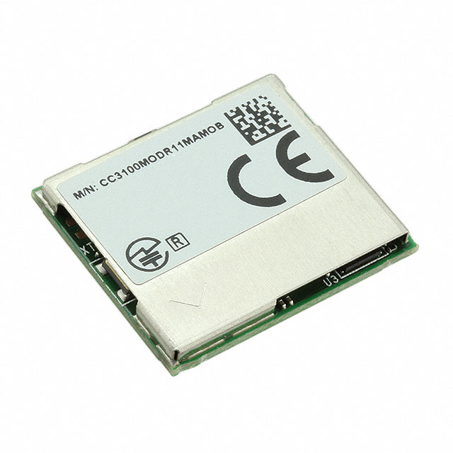
WiFi Module
CC3100/3200MOD
802.11bgn compatibility
Fully enclosed external hardware
Same operational voltage as MCU
7㎂ Hibernate power consumption with RTC
140㎂ standby

Slide 14
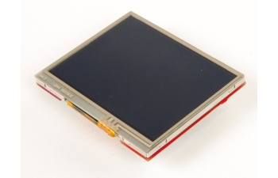
LCD Display
BOOSTXL-K350QVG-S1
320x240 resolution
SPI Interface
Self-contained external components
4 wire resistive touch capacity

Slide 15
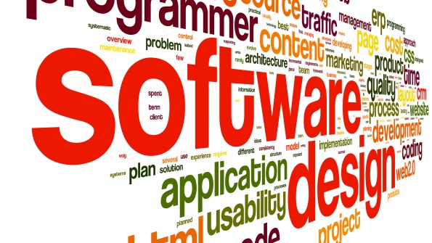
Software Design Approach
General
Modularize the software
Test Driven Development (TDD)
Web API
Intuitiveness & Consistency
Security
Documentation
Notes:
Script:
Throughout the programming of the multiple aspects of our project these are a few things that we are focusing on.
We are aiming to keep our code in general as modular as possible. The idea is that modularity allows for ease of testing given that it is breaken up into tiny simplisitc pieces and thus also lends itself to code reuse
Which allows us to mitigate opportunities for error given that there would be a single source per functionality.
We are developing our software using something called Test Driven Development aka TDD. This style of development relies on very short development cycles that focus on passing a test such as, press a button on the gui and the fan would turn on.
For the Web API I am keeping in mind that the person that will be using this will be another developer and so I must for their sake attempt to make the API as Intuitive and Consistent as possible. Essentially if we have route for example with a URI of /api/roast and it is a POST request in order to create a roast, I would expect that the same URI used with a GET request would allow you to pull roast profiles and it does do so.
For security we want to ensure that only the owner of a given roaster is able to control their given roaster and in order to do so we use a technology that I’ll outline in a future slide.
I no we all hate to write documentation, but we have to keep in mind that only thing worse than writing documentation is working with software that has none. So basically we focused on ensuring that our code is fairly well documented.
Modular
functions are grouped in the same unit of programming code and separate functions are developed as separate units of code so that the code can be reused by other applications.
TDD
process that relies on the repetition of a very short development cycle: requirements are turned into very specific test cases, then the software is improved to pass the new tests, only.
Intuitiveness & Consistency
Security
Documentation
Do you hate documentation? Well, I can empathize, but put on your “user perspective” hat and I’ll bet that the one thing you hate more than having to write documentation is having to try to use an undocumented API. I rest my case.
Interrupt Driven

Slide 16
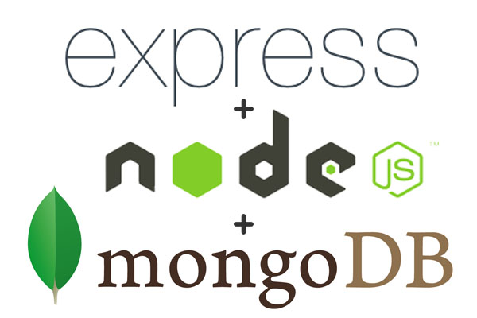
Web API
What will it do?
Will facilitate communication between front end applications and the coffee roaster
Store user data, such as:
User credentials
Roast profiles
User’s favorites roast list
Provide Authentication/Security
What is your Web API stack?
MongoDB, ExpressJS, NodeJS
Notes:
The first question that everyone asks is what will the Web API do exactly?
Well the primary objective of the web api is to allow the iOS application and the coffee roaster. But beyond that it will also store user credentials, their roasting profiles they’ve created, their list of favorite roasting profiles, and also provide some security.
I know many of us especially those that work with software are fairly familiar with the MEAN stack or at least have heard of it, well for our API I stuck with the MEN stack so essentially I had no use for Angular in this project so it was not used. The primary reason is that it’s very fast to get started.

Slide 17
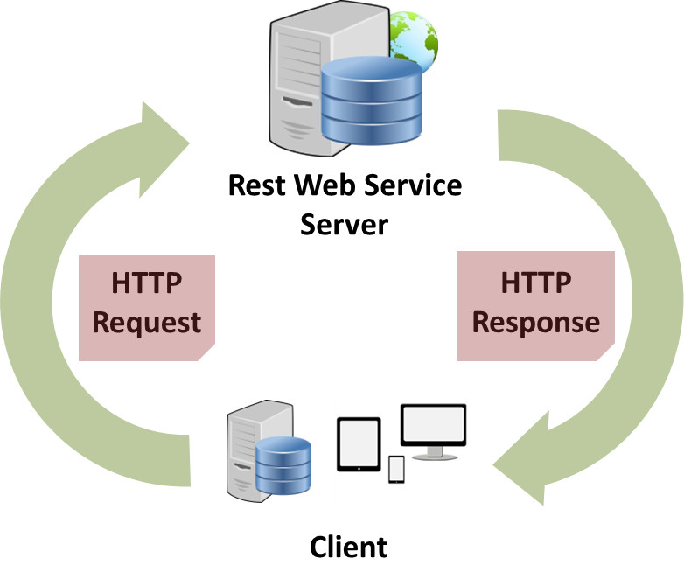
Representational State Transfer aka REST
What is REST?
Architectual style for networked hypermedia applications. Primarlily Used for building Web services that are lightweight, maintainable, and scalable.
Constraints:
Uniform Interface
Stateleness
Client-Server
Cachable
Layered System
Code on Demand (optional)
Notes:
Uniform interface
The idea is that we should keep how the client and server interface consistent. That way the server and client and evolve without to much worry for the other.
Statelessness
Essentially, what this means is that the necessary state to handle the request is contained within the request itself, whether as part of the URI, query-string parameters, bodyC, or headers.
Client-Server
The uniform interface separates clients from servers. This separation of concerns means that, for example, clients are not concerned with data storage, which remains internal to each server, so that the portability of client code is improved.

Slide 18
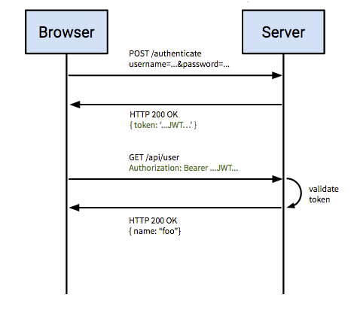
Security - JWT
What is JWT?
An open standard that defines a compact and self-contained way of securely transmitting data via a JSON object.
How will you use JWT within your Web API?
It will allow us to authenticate who the user is and what roaster should be receiving the data.

Slide 19
Routing
TYPE |  | POST
URI |  | /api/user/authenticate
Description |  | Used when logging in a user
Payload |  | POST /api/user/authenticate { “username”:”RoastMaster5000”, “password”:”1337Roaster” }
Response | Success | 200 - application/json { “Success”:true, “token”:”JWT dkafjkEefkFSjfk.afakjAWer” }
 | Failure | 200 - application/json { “Success”:false, “msg”:”Authentication failed: User not found.” }
TYPE |  | POST
URI |  | /api/roast
Description |  | Create a roasting profile.
Payload |  | POST /api/roast Set Header: Authentication = “JWT dkafjkEefkFSjfk.afakjAWer”
Response | Success | 200 - application/json { “roastname”:”French Roast”, “beanType”:”Peruvian”, “roastType”:”Dark”, “roastingData”: ”(0,150,20),(39,200,44), (400, 225, 10),(500,0,0)” }
 | Failure | 200 - application/json { “Success”:false, “msg”:”No roasts found.” }
Notes:
If the user would like to get a list of their favorite roasts the client would make use the necessary GET HTTP Request and ensure that the header includes their JWT token.

Slide 20
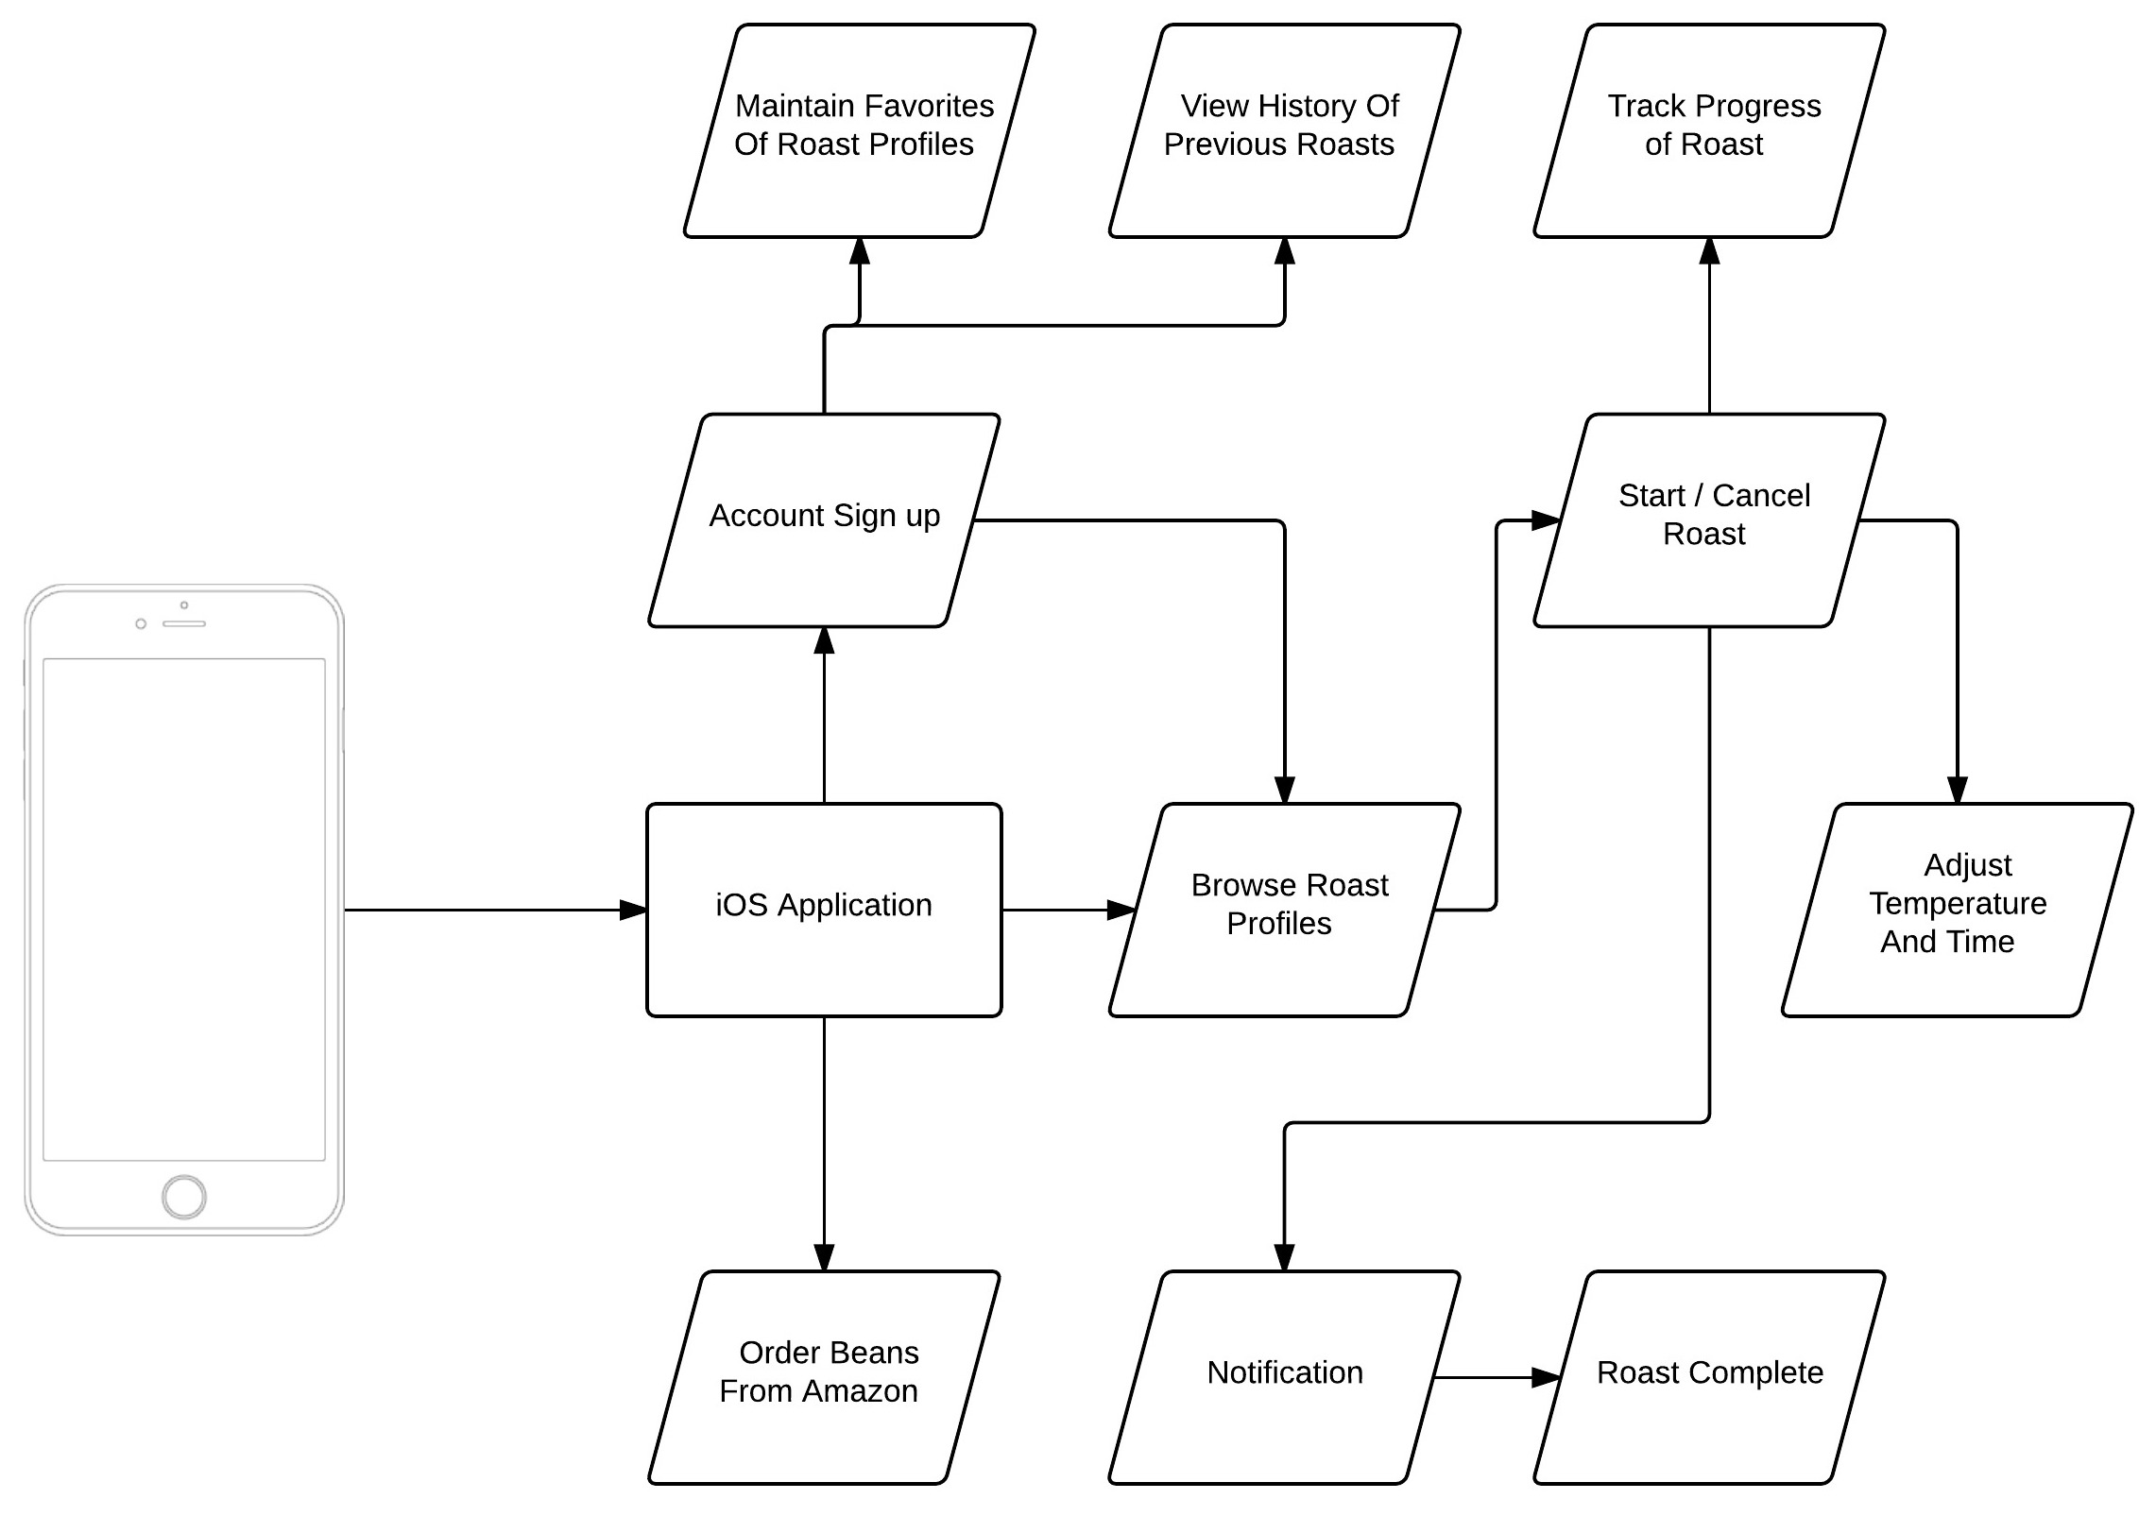
iOS Block Diagram
Full control of coffee roaster
Begin and track a roast in progress
Notification when roast is complete
Browse & Add new roast profiles

Slide 21
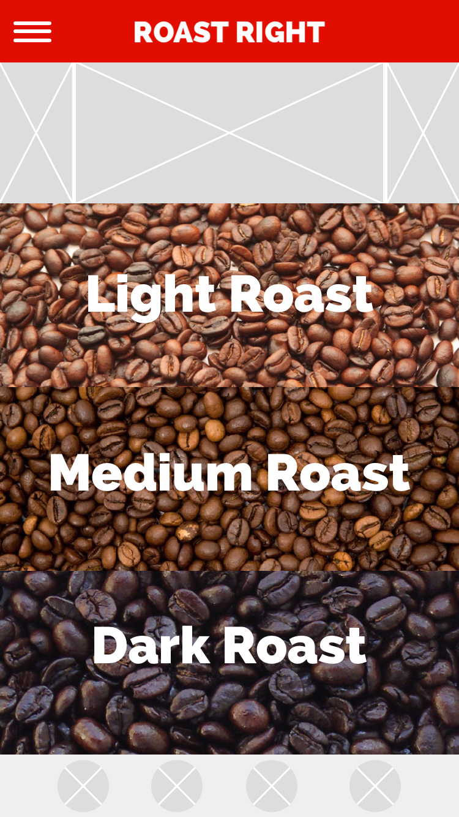
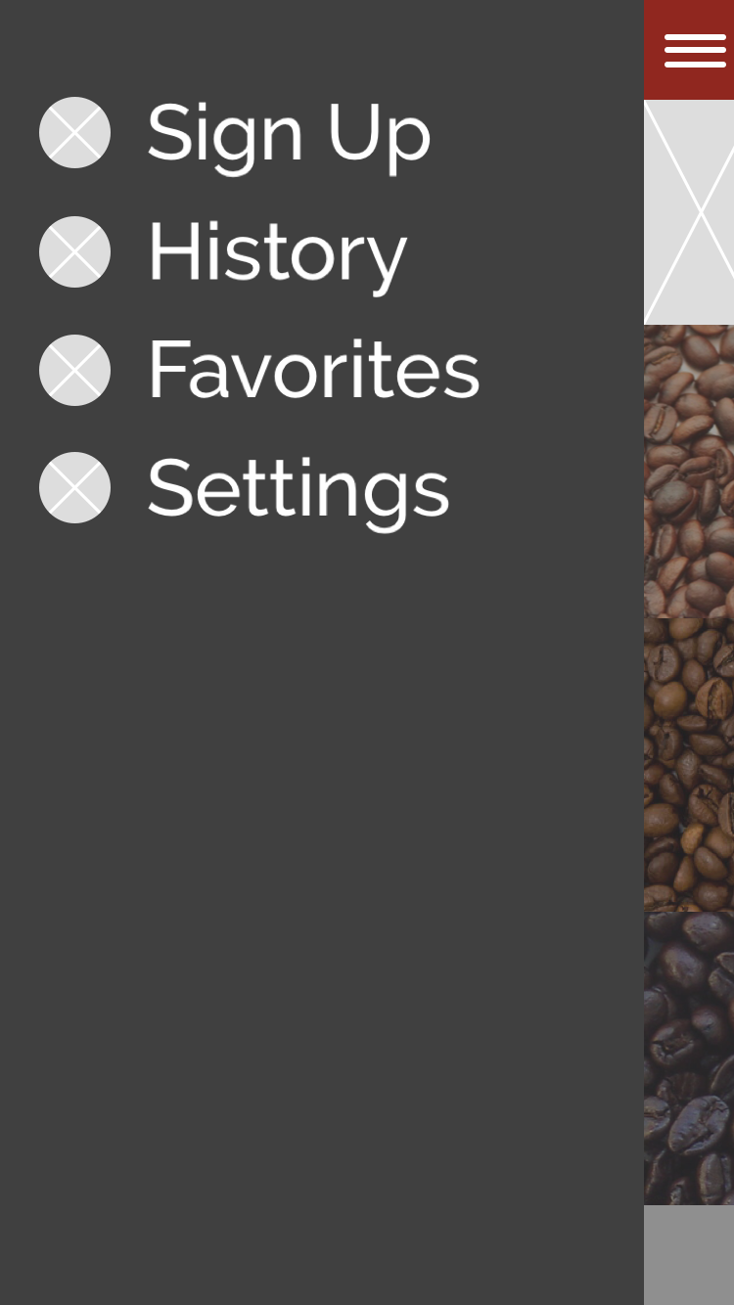
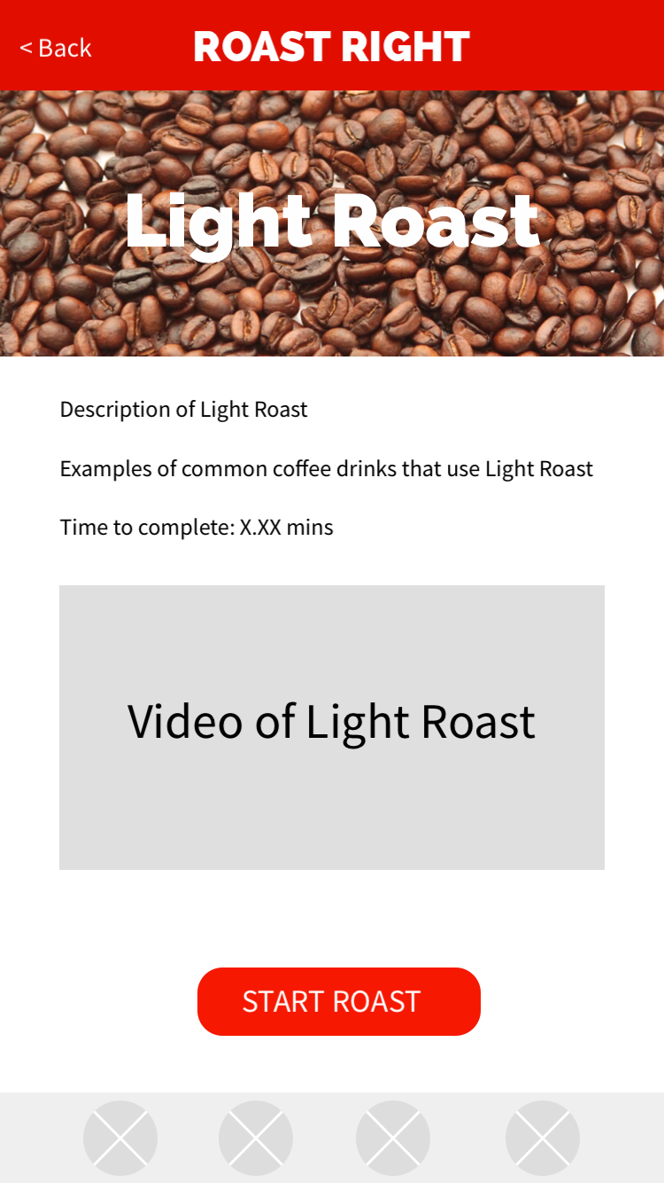
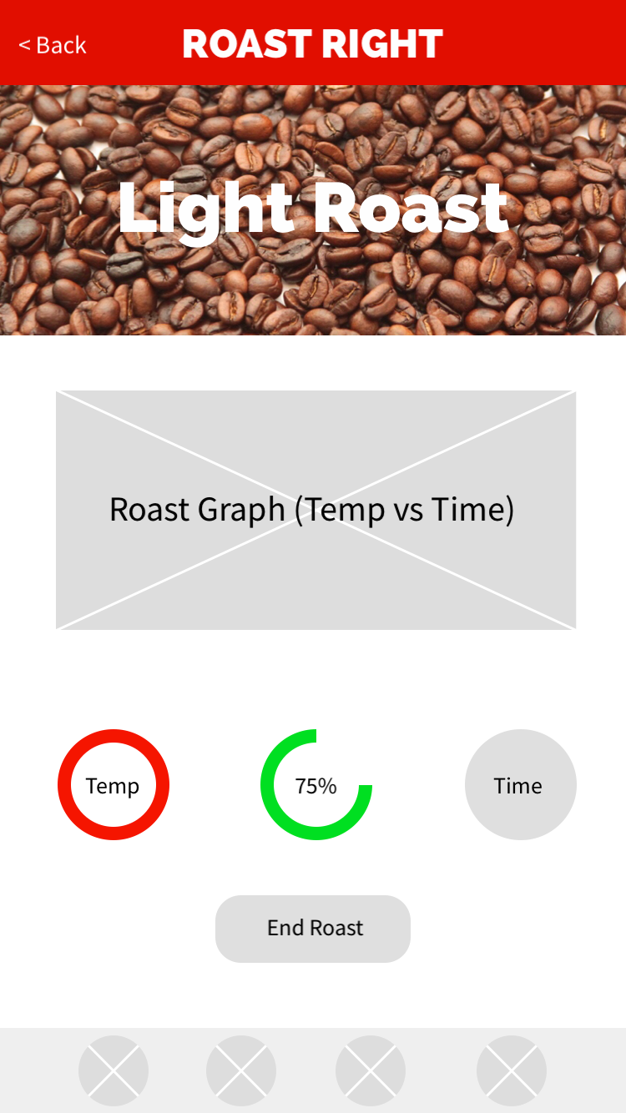
iOS Application

Slide 22
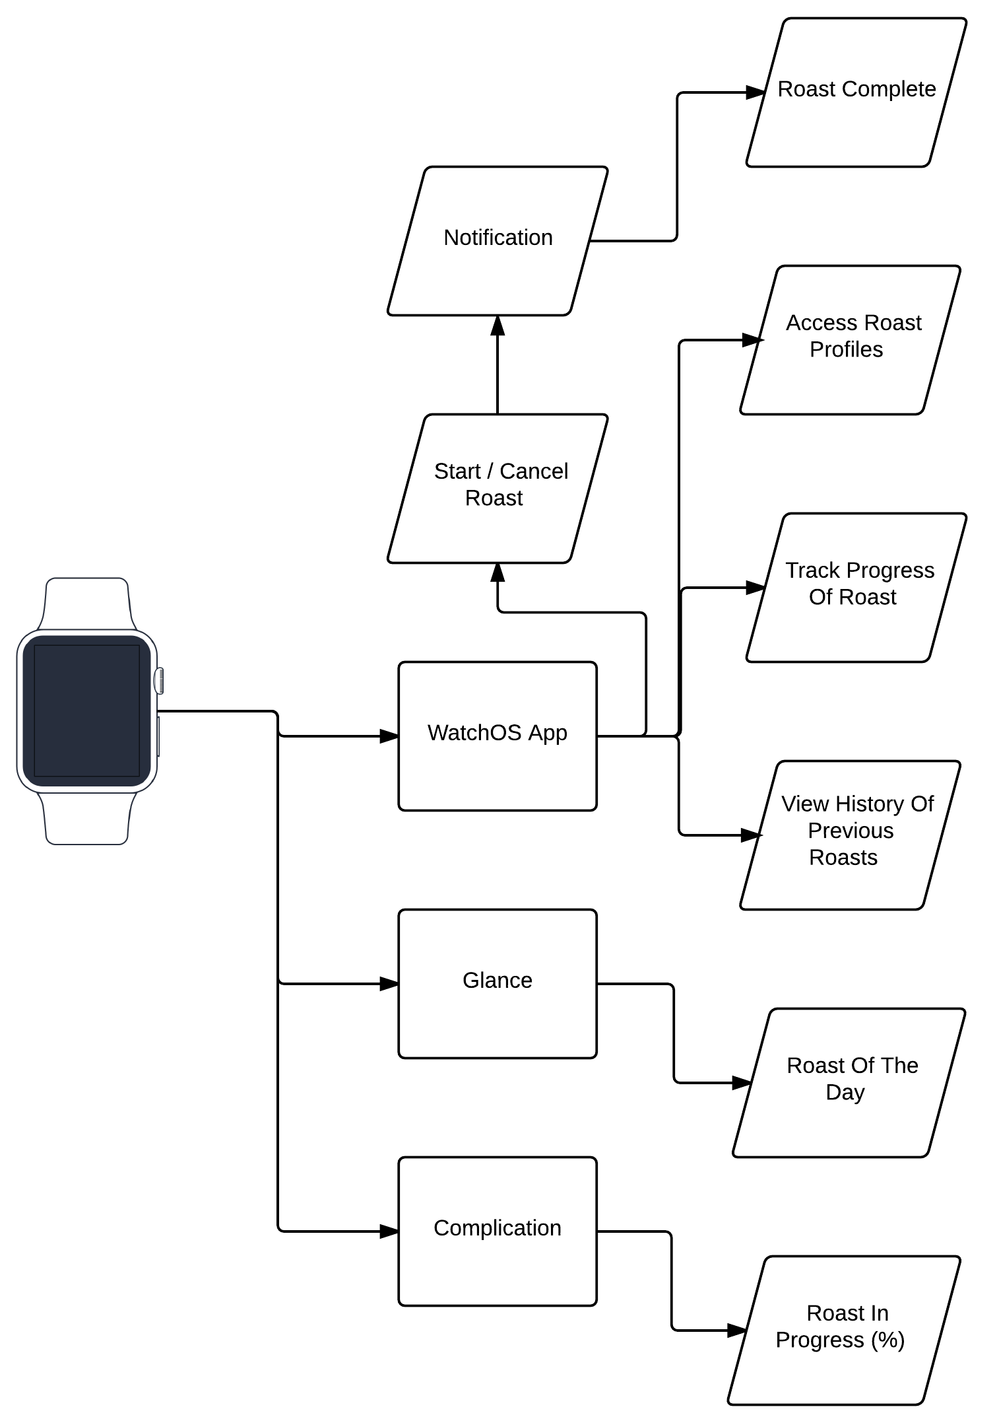
watchOS Block Diagram
• The watchOS application is comprised of 3 major components:
• watchOS Application
• Glance
• Complication

Slide 23
Project Successes & Concerns
Success
Hardware
Meets design requirements
Produces the best coffee you’ve ever had
Concerns
Hardware
Problems in high power circuitry
Crack detection misfires
Software
Latency between iOS/watchOS applications communicating with coffee roaster in a timely manner
Intuitive design due to using familiar UI and functionality from popularly used apps

Slide 24
Budget and Financing
Behmor Coffee Roaster | $395.89
PCB Manufacturing | $250.00
AC Power Control System | $75.73
Equipment | $45.00
DC Power System | $25.57
PCB Placement | $25.00
Crack Detection | $18.14
Miscellaneous Expenses | $15.00
DC Power Control System | $2.19
Total | $852.32
Project is largely self-funded with minor funding coming from external sponsors including
Sweet Maria’s Coffee
8 LBs of unroasted coffee of several varieties
Blessed Beans Coffee
25 LBs of unroasted coffee from a single source
Texas Instruments
$100 eStore funded by TI Innovation Challenge

Slide 25
Hardware Progress
Key:
Brian
Patrick
Brian & Patrick
Research
95%
Subsystem Schematics
95%
Main Schematic and PCB
30%
Procurement
45%
Overall Progress
50%

Slide 26
Software Progress
Key:
Evan
Sammy
Evan & Sammy
iOS Application
75%
watchOS Application
Begins once iOS Application is complete
Web API
40%
Embedded Software
20%
Website
85%

Slide 27
Immediate Plans for Project
Hardware
Finish procurement of components
Begin breadboard testing
Complete Main System
Verify schematic is accurate and passes ERC
Route PCB and verify it passes ERC
Software
Finalize iOS application and begin watchOS application
Begin testing of iOS application and Web API

Slide 28
Questions?

